Slide 1



Prediction of Loan Approval using Machine Learning Algorithms

Slide 2

Group Members
Chaitanya Kamlekar | 700741248
Murali Yaswanth Motamarri | 700741647
Hirthik Rahul Siripurapu | 700743845
Uttam Kumar Gowda Matta | 700740581

Slide 3
Roles, responsibilities and contribution
Person | Task | contribution
Murali Yaswanth Motamarri (700741647) | Data Collection, Cleaning the data and Documentation | 25%
Uttam Kumar Gowda Matta (700740581) | Feature Extraction and Documentation | 25%
Chaitanya Kamlekar (700741248) | Implementing Machine Learning Algorithms and Documentation | 25%
Hirthik Rahul Siripurapu (700743845) | Implementing Machine Learning Algorithms and Documentation | 25%

Slide 4
Motivation
Loans play an important role in the banking sector as they are the main source of revenue for the banking industry.
Banks receive multiple applications every day. Accepting loans is a crucial activity for banking organizations, and loan recovery is an essential factor in a bank's financial performance.
Even though the approval is done based on rigorous verification, there is still no guarantee that the chosen applicant is the most deserving candidate among all applicants.
Humans take a lot of time and mistakes can occur because there are many factors involved in approval of loan application.
Hence using machine learning models trained on historical data collection plays a significant role in loan prediction.

Slide 5
Objectives
The main objective of this project is to provide a quick, easy, and effective method of choosing eligible applicants and expedite the loan approval process.
The primary goal of this project is to approve loans for the right candidates so that the genuine person will not be affected by the approval procedure and do not get declined for the loan.
In this project we compare various machine learning algorithms for predicting the loan and analyse various algorithms based on metrics.
The following are the algorithms we used in this project.
1. Logistic Regression
2. K-Nearest Neighbor classifier
3. Random Forest classifier
4. Decision tree classifier
5. Support Vector Machine

Slide 6
RELATED WORK
There are several financial institutions where machine learning algorithms are being used in loan processing.
Machine learning algorithms are being used in companies to overcome the Risk of Corporate Credit, Risk of Consumer credit, Risk of Person-to-Person Lending.

Slide 7
PROBLEM STATEMENT
There are various kinds of loans such as personal loan, business loan, vehicle loans, etc.,
The eligibility of a customer is verified before approving any loan.
The customers are required to fill a form with several details and to verify all those details manually, is a hectic task and requires a lot of man-power and time.
By using these machine learning algorithms, we can point out the customers who are eligible for the loan and banks can concentrate on those customers, saving time and which helps in building customer satisfaction.
However, the advantages can only be realized if the bank has a strong model to precisely predict which customer's loan it should approve and which to reject, in order to reduce the risk of loan default.

Slide 8
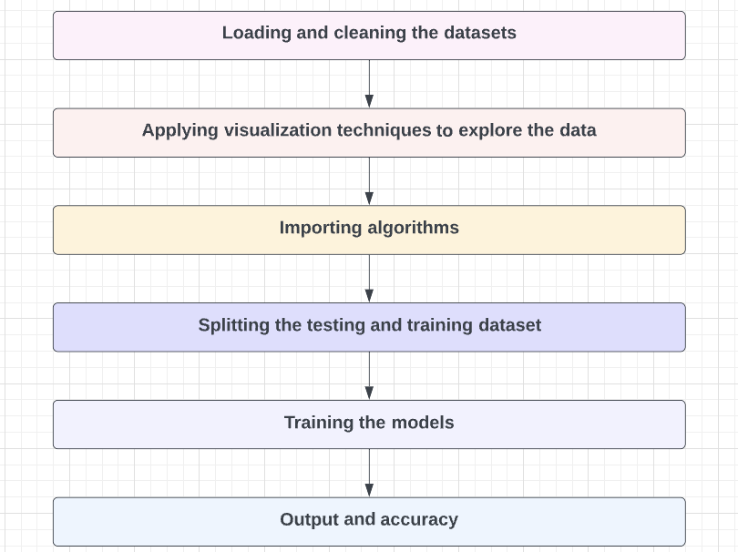
Proposed Solution

Slide 9
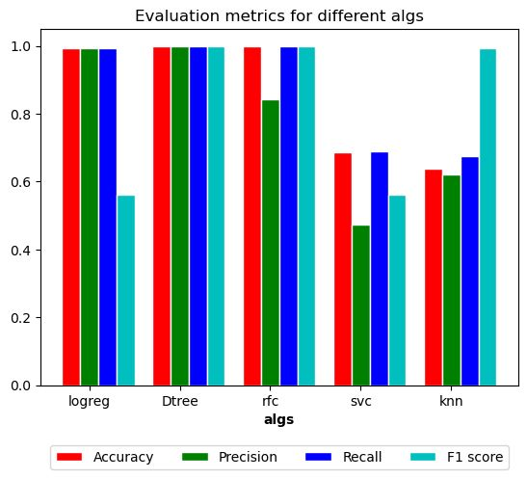
RESULTS and SIMULATIONS
Machine Learning Classifiers | Evaluation Metrics
 | Accuracy (%) | Precision | Recall | F1 score
Logistic Regression | 99.35 | 0.9935 | 0.9935 | 0.9934
Decision Tree | 100 | 1.0 | 1.0 | 1.0
Random Forest Classifier | 100 | 1.0 | 1.0 | 1.0
Support Vector Machine | 68.83 | 0.4737 | 0.6883 | 0.5612
KNeighbors Classifier | 67.53 | 0.6201 | 0.6753 | 0.9934

Slide 10
References
Mohammad Ahmad Sheikh, Amit Kumar Goel, Tapas Kumar, "An Approach for Prediction of Loan Approval using Machine Learning Algorithm," 2020 International Conference on Electronics and Sustainable Communication Systems, ISBN: 978-1-7281-4108-4
Kashvi Taunk, Sanjukta De, Srishti Verma, Aleena Swetapadma, “A Brief Review of Nearest Neighbor Algorithm for Learning and Classification”, 2019 International Conference on Intelligent Computing and Control Systems, ISBN: 978-1-5386-8113-8
Mohamed Alaradi, Sawsan Hilal,” Tree-Based Methods for Loan Approval”, 2020, International Conference on Data Analytics for Business and Industry: Way Towards a Sustainable Economy
Sourish Ghosh, Anasuya Dasgupta, Aleena Swetapadma, “A Study on Support Vector Machine based Linear and Non-Linear Pattern Classification”, 2019, International Conference on Intelligent Sustainable Systems, ISBN: 978-1-5386-7799-5
K. Arun, G. Ishan, and K. Sanmeet, “Loan Approval Prediction based on Machine Learning Approach”, IOSR Journal of Computer Engineering, pp. 18-21, 2009.
V. Nagajyothi, “Loan approval prediction using KNN, decision Tree and Naïve Bayes models”, International Journal of Engineering in Computer Science, vol. 2, pp. 32-37, 2020.
R. Kumar, V. Jain, P.S. Sharma, S. Awasthi, and G. Jha. “Prediction of Loan Approval using Machine Learning”, International Journal of Advanced Science and Technology, vol. 28, pp. 455-460, 2019.
https://www.kaggle.com/datasets/altruistdelhite04/loan-prediction-problem-dataset?select=train_u6lujuX_CVtuZ9i.csv

